Slide 1
The roles of hormones in the menstrual cycle
IGCSE Biology
https://healthfully.com/268706-can-low-progesterone-keep-the-hcg-levels-from-rising.html

Slide 2
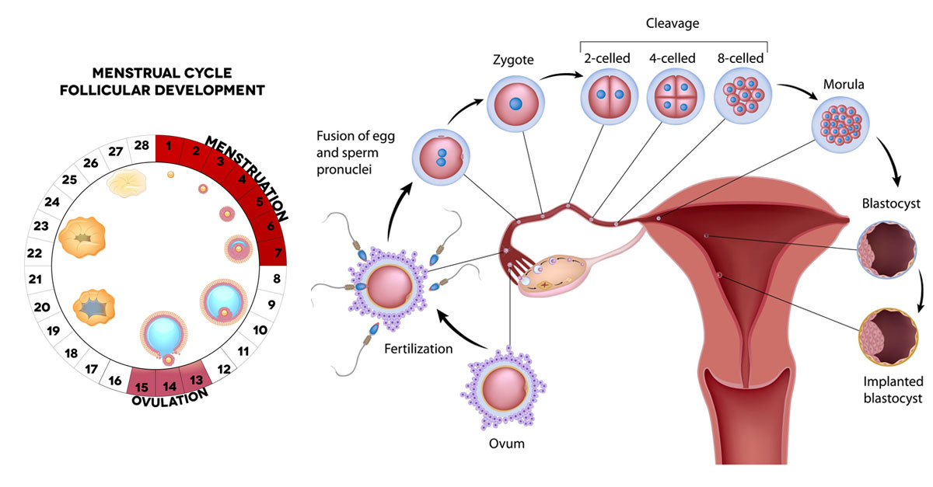
Menstrual cycle
A menstrual cycle is calculated from the first day of your period to the first day of the next period.
Q: When is the first day of a menstrual cycle? When does ovulation occur?

Slide 3
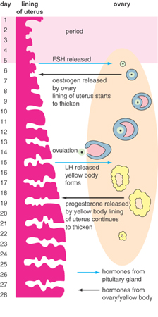
Days 1 – 5: menstruation takes place.
Day 14: ovulation takes place.

Slide 4
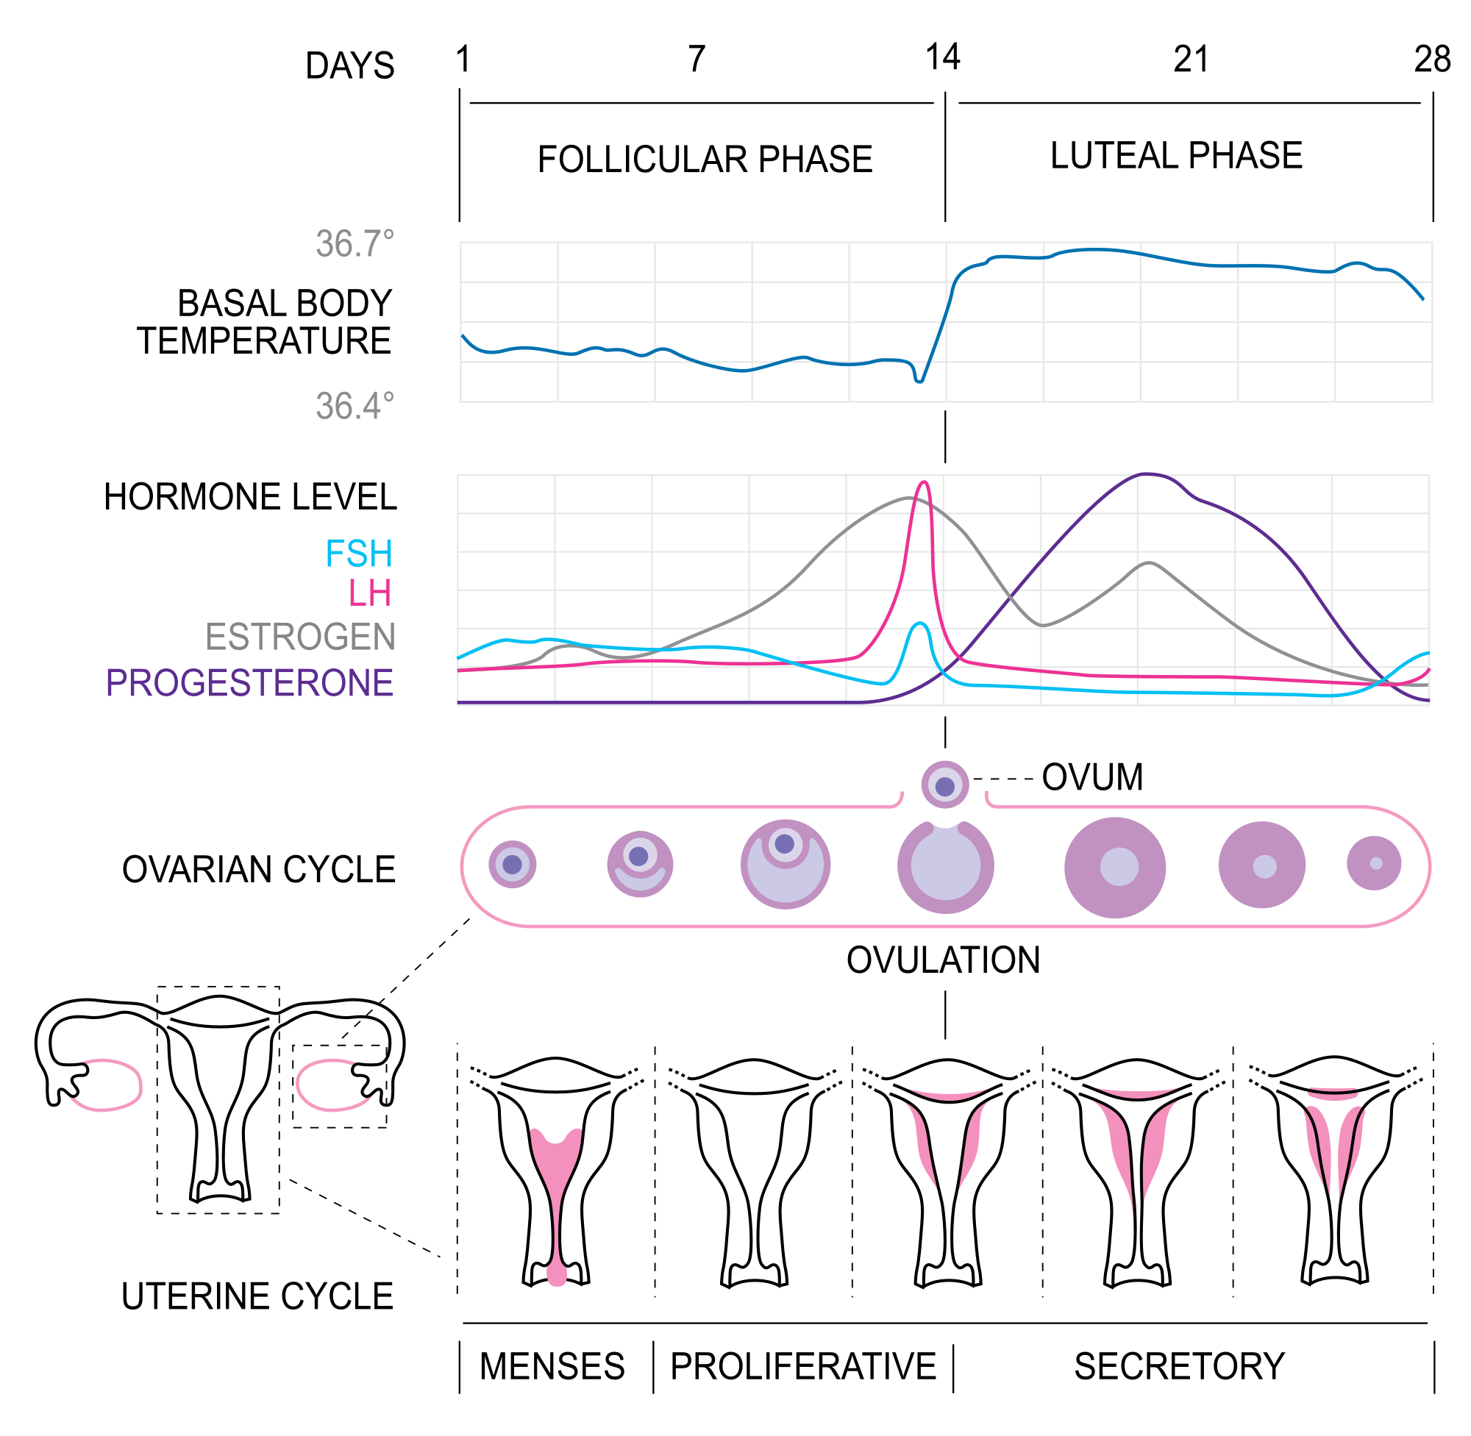

Slide 5
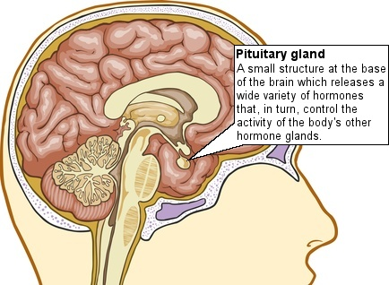
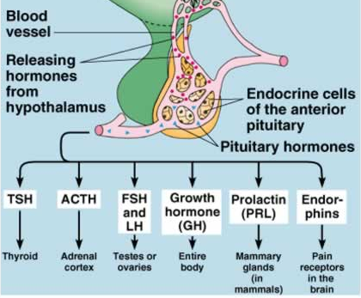
The pituitary gland
Hormones from the pituitary gland control the menstrual cycle.
These are the ones we are interested in.

Slide 6
FSH
The pituitary gland releases a hormone called follicle simulating hormone (FSH). This stimulates a follicle to develop in one of the ovaries.
A follicle is a structure in which an egg cell is surrounded by a small group of cells.
Cells in the follicle start to secrete oestrogen into the blood.

Slide 7
Oestrogen
Oestrogen makes the uterus lining thicker to prepare for the arrival of a fertilised egg. (Estrogen promotes the rapid growth of cells lining the uterus called the endometrium in preparation for possible implantation and pregnancy. )
It also prevents any more eggs from developing.
Oestrogen passes in the blood to the pituitary gland and stops it making any more FSH, thus no development of more follicles.
make the mucus in cervix become thin.

Slide 8
LH
The pituitary gland produces another hormone called luteinising hormone (LH).
LH travels in the blood to the ovary, where it stimulates the release of an egg – ovulation.
LH also stimulates the remaining follicle cells to form a yellow body.

Slide 9
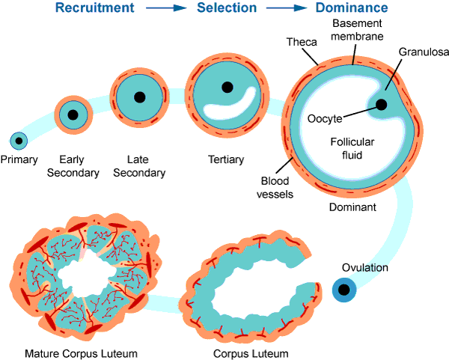
Yellow body
The egg cell (oocyte) is released from the ovary and travels down the Fallopian tube – where it may be fertilised.
Yellow body: produces progesterone

Slide 10
Progesterone
The yellow body starts to produce the hormone progesterone, which makes the uterus lining even thicker and prevents it breaking down.
prevents from menstruation;
inhibition of FSH secretion;
(make the mucus in cervix become thick again)
Both oestrogen and progesterone are needed to prepare the uterus lining for implantation of the fertilised egg. The combination of high estrogen and progesterone levels suppress further ovulation during pregnancy.
https://www.healthywomen.org/your-health/progesterone/overview
Notes:
One of progesterone's most important functions is to cause the endometrium to secrete special proteins during the second half of the menstrual cycle, preparing it to receive and nourish an implanted fertilized egg.
The combination of high estrogen and progesterone levels suppress further ovulation during pregnancy.
Progesterone also encourages the growth of milk-producing glands in the breast during pregnancy.
If pregnancy occurs, the implanting embryo produces human chorionic gonadotropin, or hCG, which keeps the corpus luteum functional so that it can continue secreting progesterone to support the pregnancy until the placenta is developed enough to take over progesterone production.

Slide 11
Menstruation
If pregnancy occurs, oestrogen and progesterone continue to be produced.
They make sure the uterus lining remains thick and they stop the menstrual cycle starting again.
If implantation does not happen, the lining of the uterus breaks down/ degenerates/ disintegrates/ sheds and is followed by menstruation.

Slide 12
Sites of production
Hormones produced by the pituitary gland | Hormones produced in the ovaries
Follicle stimulating hormone (FSH) | Oestrogen (produced by the developing follicle)
Luteinising hormone (LH) | Progesterone (produced by the yellow body)

Slide 13

The events in menstrual cycle
https://embryo.asu.edu/pages/estrogen-and-menstrual-cycle-humans
The phases that make up the menstrual cycle include the follicular phase, the ovulatory phase, and the luteal phase.

Slide 14
The follicular phase
Drop in hormone levels signals the endometrium layer to shed, resulting in menstrual bleeding.
Egg development and menstrual bleeding both occur
FSH increases and stimulates the growth of multiple ovarian follicles.

Slide 15
The follicular phase
Each follicle contains a developing egg. Later in the follicular phase, FSH levels start to decrease and only one follicle grows to maturation (the dominant ovarian follicle).
The dominant ovarian follicle begins producing estradiol during the follicular phase.
When it begins to produce estradiol, the remaining stimulated follicles break down.
The increase in estradiol stimulates the production of luteinizing hormone, which begins the next stage of a menstrual cycle.

Slide 16
Ovulatory phase
A sharp increase/ surge in LH.
Ovulation from the dominant ovarian follicle (fourteen days before the onset of a woman's next menstrual period)
If a fertilized egg implants to the uterine wall, the menstrual cycle stops and pregnancy begins.

Slide 17
luteal phase
The dominant ovarian follicle develops into the corpus luteum
The corpus luteum produces a slight amount of estradiol and a much larger amount of progesterone
Endometrium thicken
the milk ducts in the breasts to dilate and become larger, resulting in swelling and possible breast soreness prior to the onset of menstruation

